Slide 1




DevOps & Next Steps Exam 70-535 Certification Jump Start
Ken Muse
@atlantabass
Microsoft Azure MVP
Microsoft ALM | DevOps Ranger
Ken Muse | @AtlantaBass
Consulting & Training

Slide 2






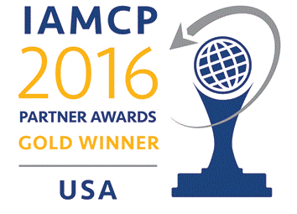
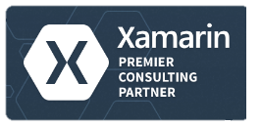
About Me
DevOps & Azure Practice Lead at
Consulting Custom software application development & architecture
Instructor Led Training Microsoft’s #1 training vendor in DevDiv
On-Demand Training World class, subscription-based online training
Ken Muse
@atlantabass
Microsoft ALM | DevOps Ranger
Microsoft Azure MVP
Microsoft Azure Advisor
Ken Muse | @AtlantaBass
Consulting & Training

Slide 3
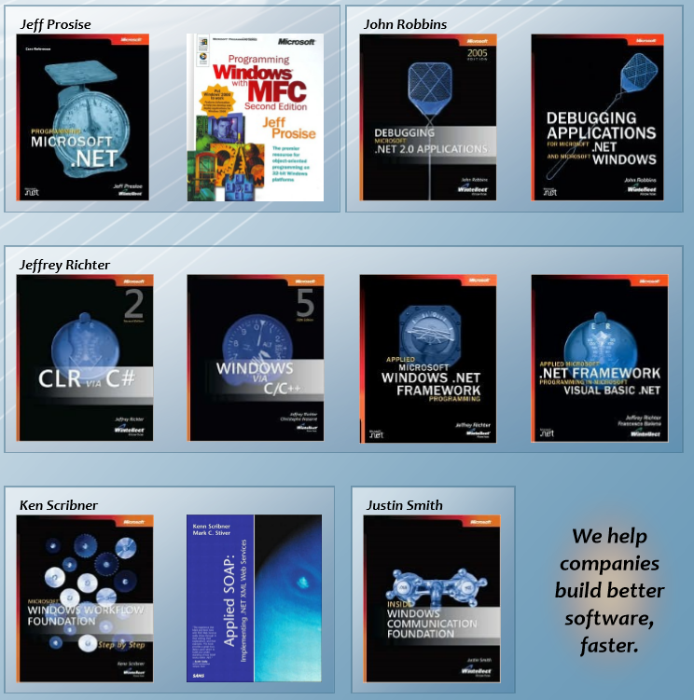
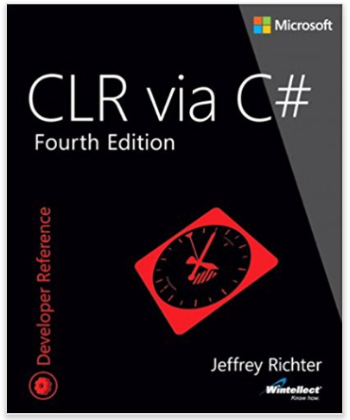
Industry Influencers We wrote the book (over 30 of them)
Ken Muse | @AtlantaBass
Consulting & Training

Slide 4


Exam Jump Start 70-535 Architecting Microsoft Azure Solutions DevOps and Next Steps
Program Home: https://aka.ms/certup
Content Home: http://github.com/guruskill/70-535
Join…
ITProGuru.com/Join
Microsoft Virtual Academy
Notes:
http://aka.ms/certification/70-535
https://mslibrary.measureup.com/

Slide 5
Architect Defined
Given Challenge
<=>
Create Solution
Noun:
A person who designs and in many cases also supervises construction
The deviser, maker, or creator of anything
Verb:
To plan, organize, or structure as an architect: The house is well architected.

Slide 6


Translate Business Objectives Into Actions
Identify Problems (especially root problems)
Determine the requirements to solve each problem
Determine the best technology options available to help solve the problem
Identify strategic partners
Determine likely barriers
Determine additional value (if any)
Get Started

Slide 7
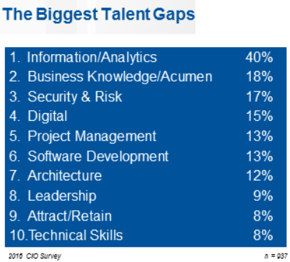

2016 CIO Priorities & Challenges
Talent has now been recognized globally as the single biggest issue standing in the way of CIOs achieving their objectives.
The biggest talent gaps are around Information/Analytics followed by business knowledge/acumen.
Understanding what is possible with the cloud can help close the gap
http://www.gartner.com/imagesrv/cio/pdf/cio_agenda_insights_2016.pdf
Notes:
http://www.gartner.com/webinar/3139617/player?commId=175277&channelId=5500&srcId=1-2973089105

Slide 8

“DevOps is the union of people, process, and products to enable continuous delivery of value to our end users.” Donovan Brown Principal Cloud Developer Advocate Cloud Developer Advocacy US @donovanbrown
What is DevOps?
Notes:
According to Donovan Brown, DevOps is the union of people, process, and products to enable continuous delivery of value to our end users.
You cannot buy DevOps and install it. DevOps is not just automation or infrastructure as code. DevOps is people following a process enabled by products to deliver value to end users.

Slide 9








DevOps is here…
Create
Release
Plan
Configure
DEV
OPS
Package
Monitor
Verify

Slide 10




DevOps is here… and driving business value
Organizations realizing up to 20% improvements in...
Create
Plan
Release
Time-to-market
Configure
Software quality
DEV
OPS
Frequency of deployment
Increased revenue
Package
Monitor
Verify
Customer reach and retention
Source: Global Study by CA Technologies

Slide 11
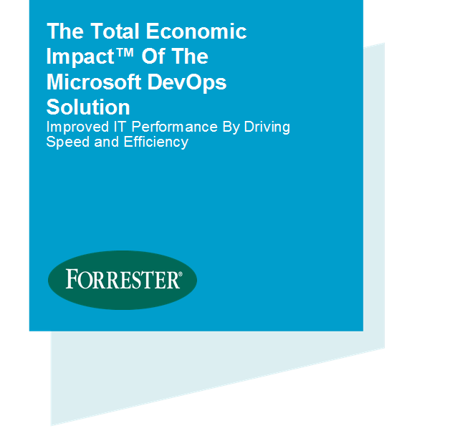
Economic impact summary
$3.9M
NET PRESENT VALUE OVER THREE YEARS
Forrester Consulting, 2016 Based on a composite organization created from surveys and interviews of actual Microsoft customers
529%
three-year, risk-adjusted ROI
80% lower
time to recover from failures
15 times
increase in deployment frequency
3 months
to total payback
Notes:
The economic benefits of DevOps are now universally recognized and accepted.
Organizations that have successfully adopted DevOps …
(Click)
Have seen a 529% ROI over 3 years
(Click)
Have reduced their time to recover from failures by 80%
(Click)
Are deploying their software 15x more frequently
(Click)
And, have seen total payback on these tools and the time spent to implement them in as little as 3 months.
And, Have better morale. Employees in high-performing organizations were 2.2 times more likely to recommend their organization as a great place to work.
As a result, these organizations are able to …
… spend 22% less time on unplanned work/rework, since we have shifted our quality activities to the left in the process
… spend 29% more time on new work, such as new features or code
… experiment in product development, by working in small batches; providing visibility into the flow of work; and gathering customer feedback to iterate.
The Microsoft DevOps solution unlocks DevOps benefits like the ones listed above in record time – investing in DevOps with Microsoft is the easiest way for Enterprise organizations to start their DevOps journey.
Visual Studio Enterprise is at the center of our DevOps solution – if team members are equipped with Visual Studio Enterprise, they have all the tools and services required for modern DevOps.
The total economic impact of the Microsoft DevOps solution
https://info.microsoft.com/the-total-economic-impact-of-the-microsoft-devops-solution.html
C:\Users\daveb\OneDrive - Microsoft\Events\The Total Economic Impact Of The Microsoft DevOps Solution.pdf

Slide 12
DevOps – delivering value in the digital era
22%
29%
50%
75.2x
less time on unplanned work/rework
more time spent on new work
less time remediating security issues
fewer outage costs due to downtime
Employees in high-performing teams are 2.2x more likely to recommend their organization as a great place to work.
Source: 2016 State of DevOps Report (Puppet & Dora), survey of 4,600 technical professionals
Notes:
Digital-minded organizations are adopting DevOps practices as the vehicle for delivering transformation, and are reaping the benefits from doing so.
High-performing organizations spend 22 percent less time on unplanned work and rework. As a result, they are able to spend 29 percent more time on new work, such as new features or code. They are able to do this because they build quality into each stage of the development process through the use of continuous delivery practices, instead of retrofitting quality at the end of a development cycle.
High performers spend 50 percent less time remediating security issues than low performers. By better integrating information security objectives into daily work, teams achieve higher levels of IT performance and build more secure systems.
And a final differentiator – by adopting DevOps standards and practices, employees are 2.2x more likely to recommend their organization as a great place to work.
Source: 2016 State of DevOps Report (Puppet & Dora), survey of 4,600 technical professionals

Slide 13
DevOps Is About …
People
Adaptive Teams
Collaborative
Continuous Improvement
Process
Visibility & Accountability
Eliminate Waste
Increase Efficiency
Feedback
Products
Flexible & Scalable
Interoperable
Enhance Productivity

Slide 14
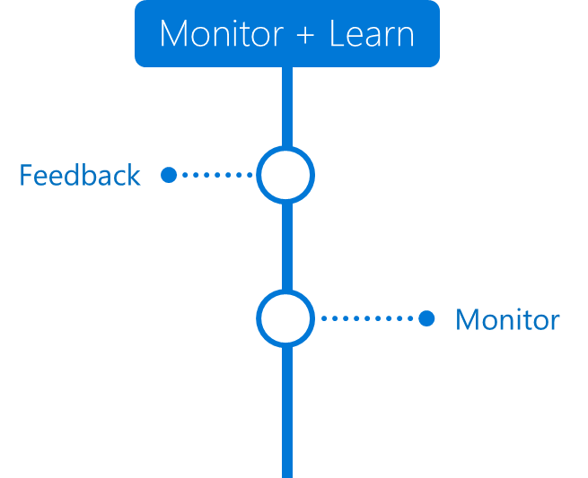
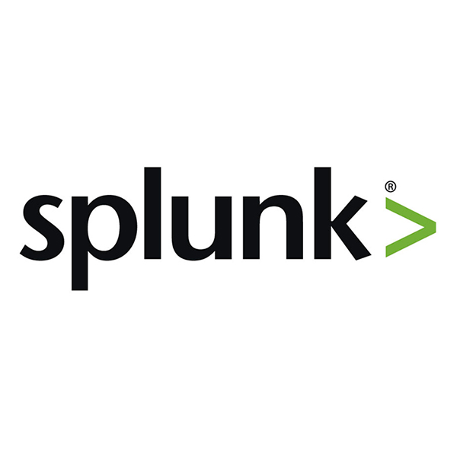


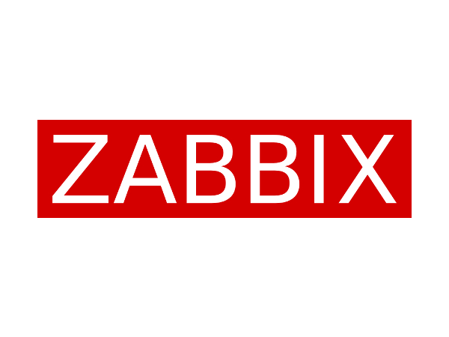
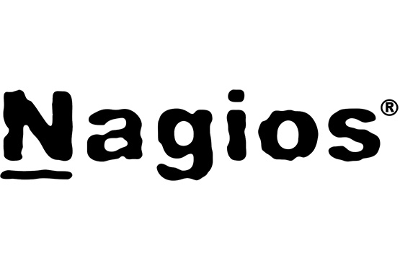
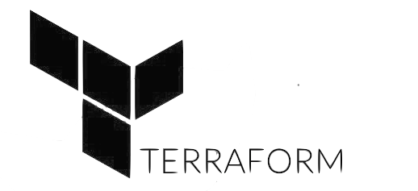
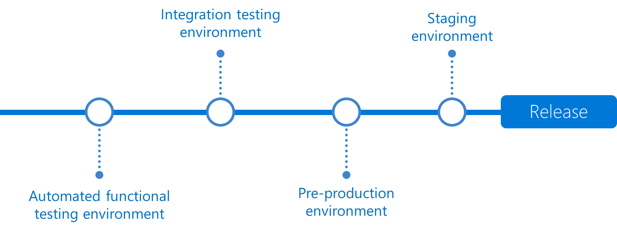
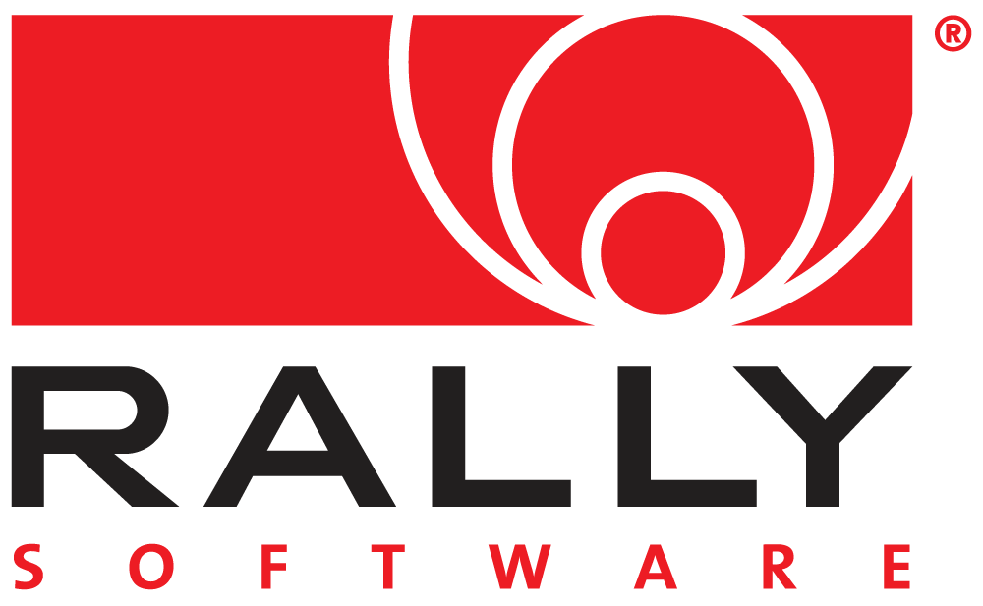



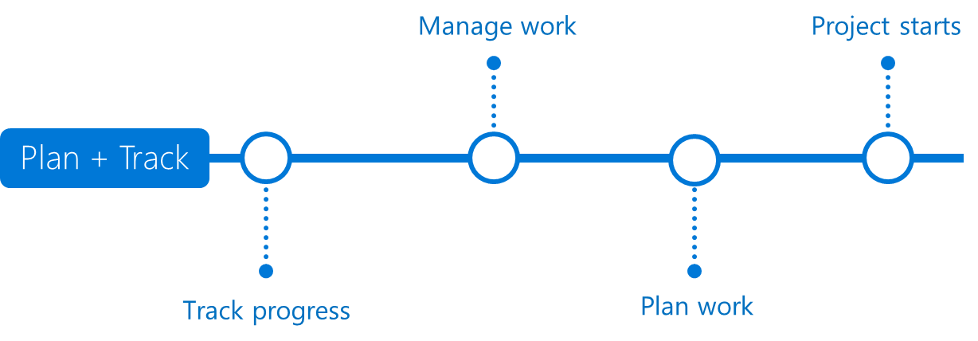

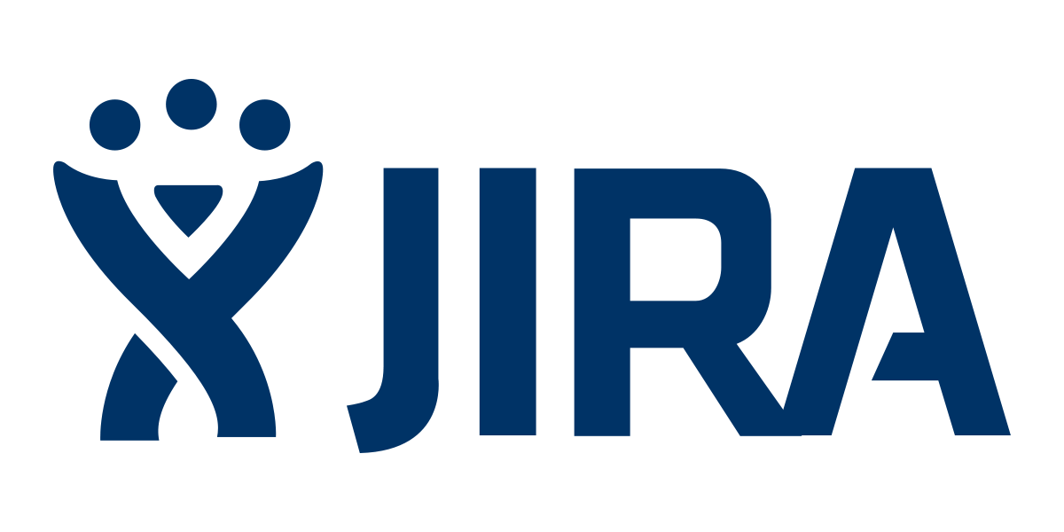

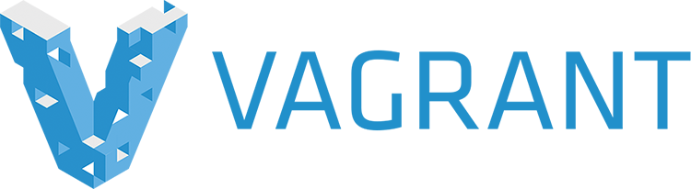





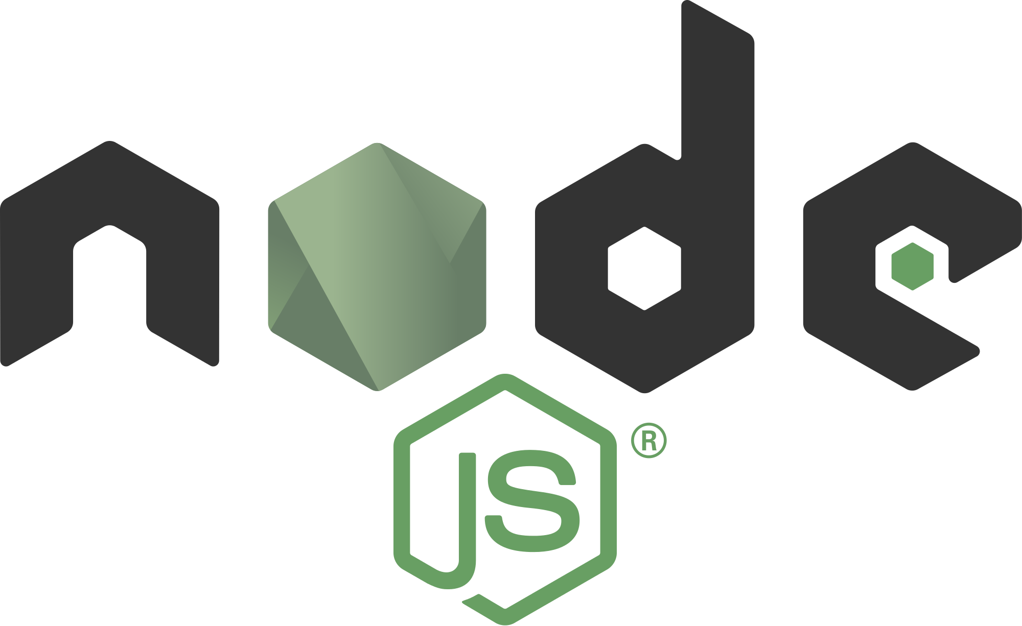
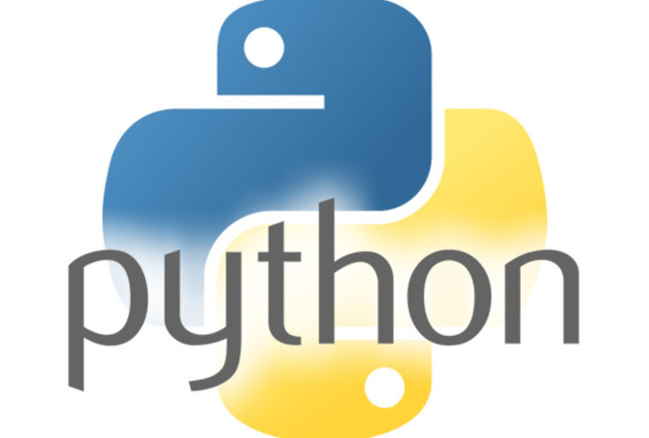
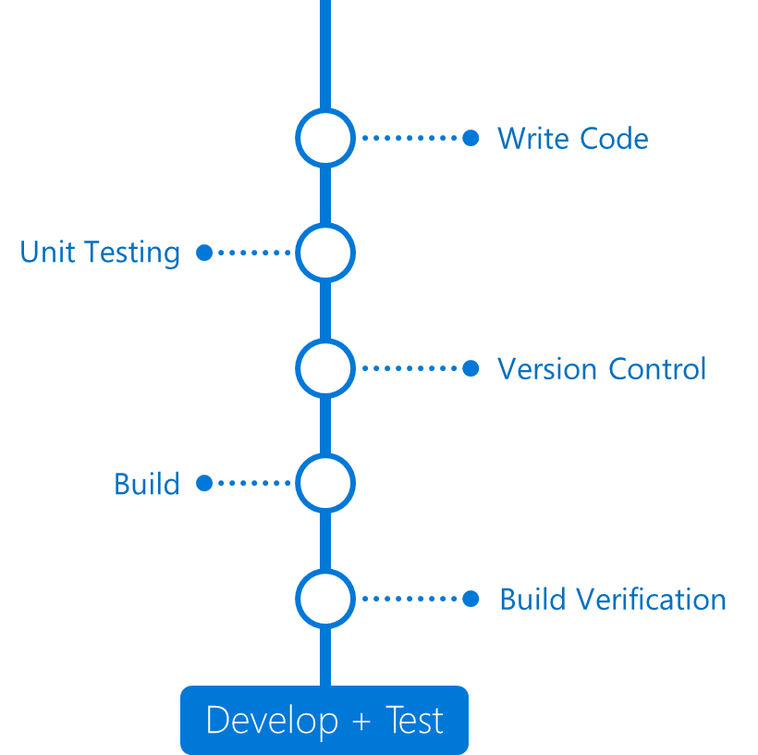

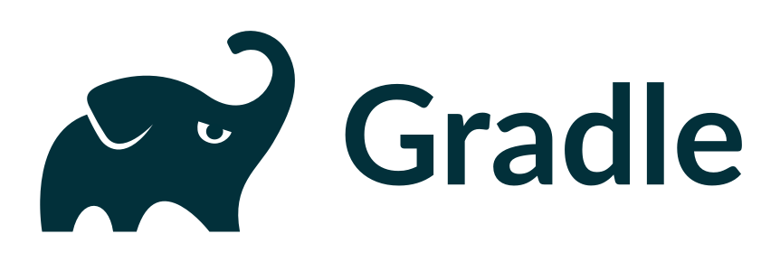

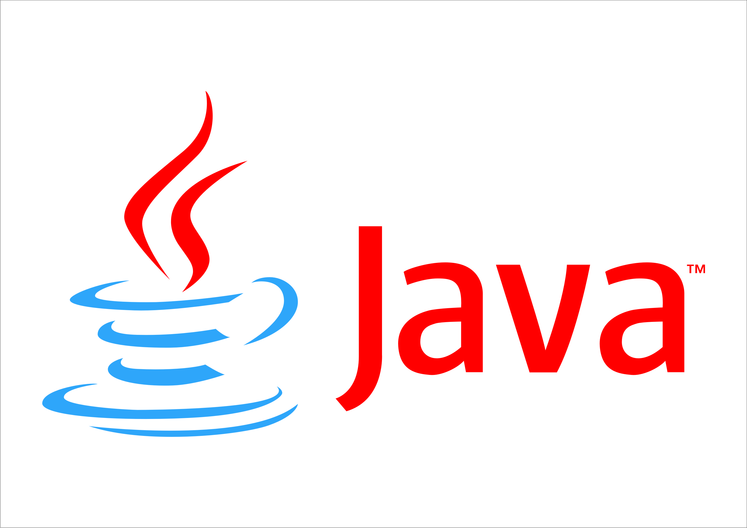
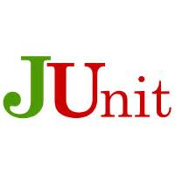
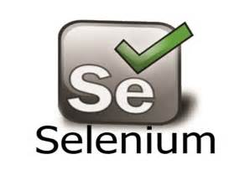
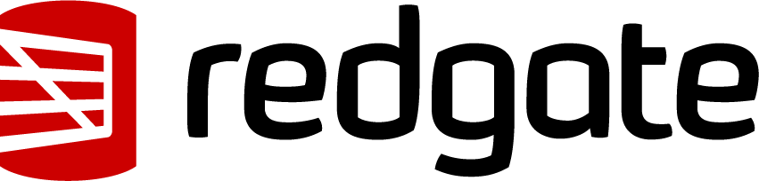
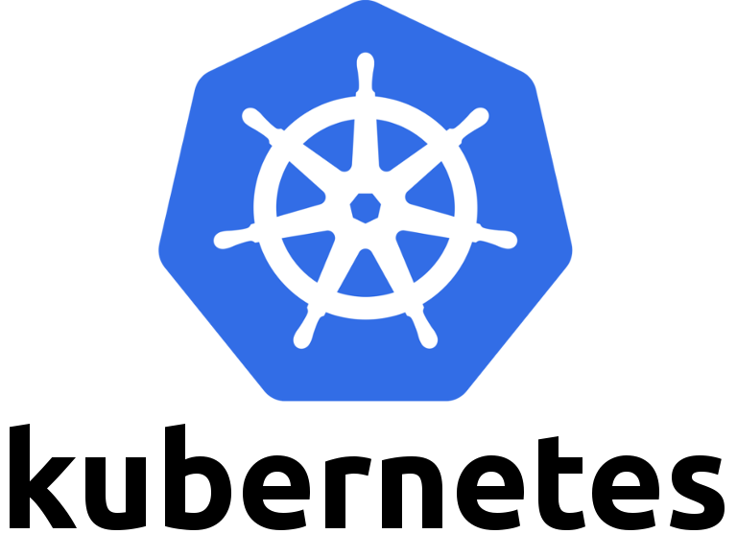

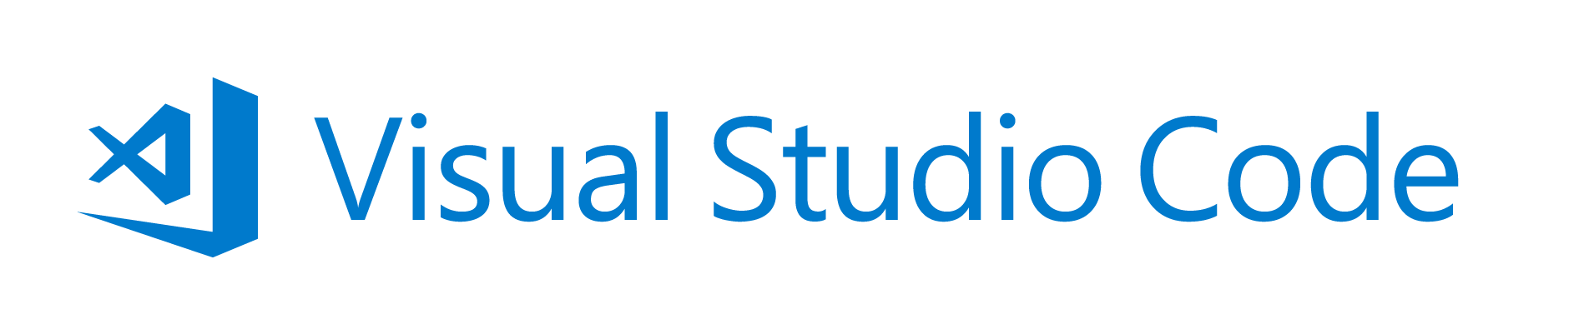

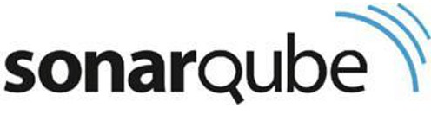
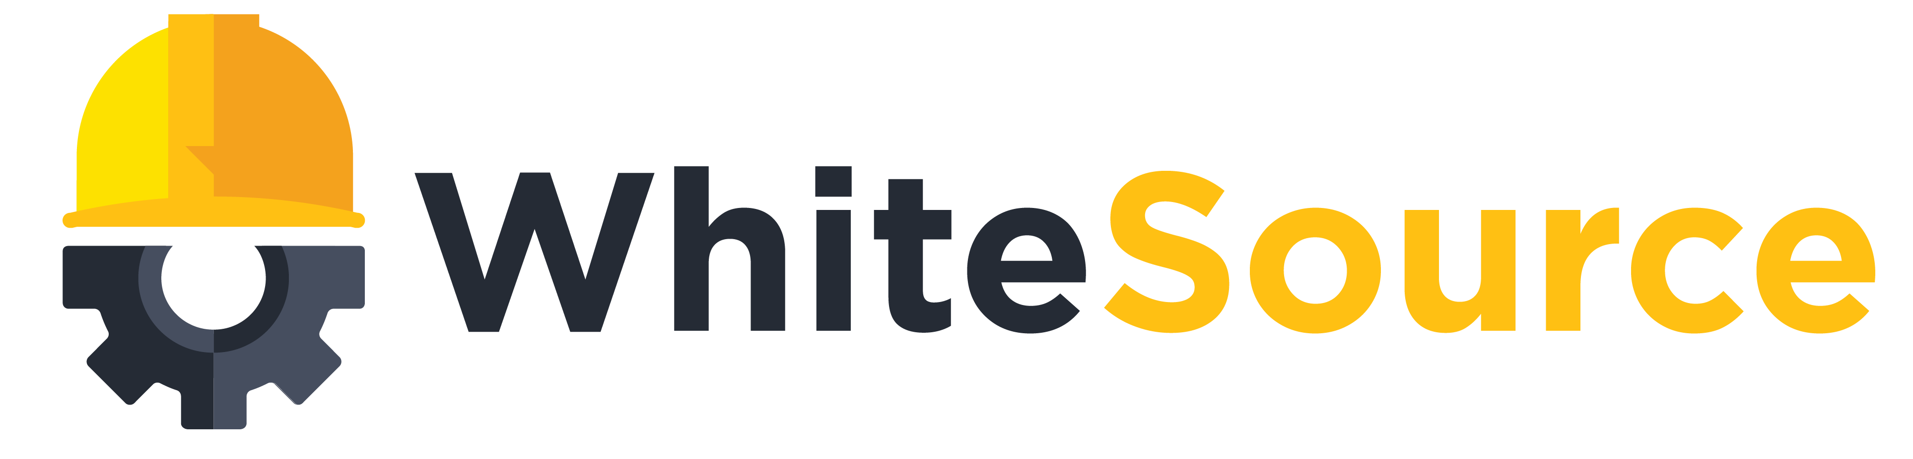
DevOps with VSTS
DevOps
DevOps is the union of people, process, and products to enable continuous delivery of value to our end users.
Application Insights
DevOps
DevOps
Visual Studio
Notes:
Continuously delivering value is about more than just automating deployments. You must start at the beginning of your development process - what you plan to deliver and how you plan to get there. In other words, planning and tracking.
[CLICK – Transition slide to show Planning phase]
Your project starts with an idea and a plan how to turn this idea into reality.
Agile approaches software development by emphasizing incremental delivery, team collaboration, continual planning, tracking and learning.
​
[CLICK – Transition slide to show development and test phase]
Although planning starts the process, the development team turns the ideas into features and capabilities during the development and testing phase.
Your development team will use the practice of continuous integration to merge code and automatically run a build process, including tests, whenever they commits a code change. ​
​
[CLICK – Transition slide to show release]
Continuous delivery will deploy your build to testing, pre-production, staging, and other environments in the release process.
It gives you quality gates throughout your release pipeline and increases confidence in your code long before production. ​
​
[CLICK – Transition slide to show monitor]
Lastly, you need to watch your solution in production. Effective monitoring delivers information about your solution’s performance, usage, and issues.
It’s essential to enable DevOps teams to deliver at speed, get feedback from production, and increase customers satisfaction, acquisition and retention.​
[CLICK – Transition slide to show other products and end with VSTS]
​Whether you are targeting the cloud, hybrid cloud, or an on-prem environment, Visual Studio Team Services, or VSTS, is the recommended Azure DevOps solution.
It allows you to plan, monitor, build and deploy to Windows, Unix, Android, or iOS, from .NET, Java, PHP, Python, Ruby, C++, and many other 3rd party and open source products such as Ant, Maven, Gradle, Junit, NUnit, xUnit, and Jasmine.
If you cannot find a task needed for your release pipeline, you can build custom tasks that integrate with VSTS and your continuous integration and continuous deployment.

Slide 15
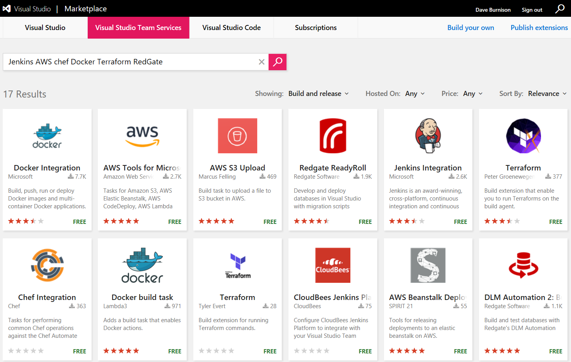
Get 3rd Party Extensions in the VSTS Marketplace
Notes:
Free and Paid extensions.
Jenkins AWS Chef Docker Terraform RedGate

Slide 16
Continuous Integration
Use hypotheses driven development
Build frequently and incrementally
Test continuously -- eliminate manual work and automate the flow of software through the build, test, and deploy cycles
Load test early and often

Slide 17
Continuous Deployment
Continuous delivery ensures code is always ready to deploy and performs as expected through automated testing on a production-like environment
Continuous deployment is a process of deploying code which passes the automated tests to production automatically.
Automatic Release
Manual Release
Build
Staging
Production

Slide 18
Continuous Feedback
Use Kanban boards to understand bottlenecks
Make it easy for customers to provide feedback
Use feature flags to encourage early adoption
Retrospectives
Use monitoring to support data-driven decisions

Slide 19
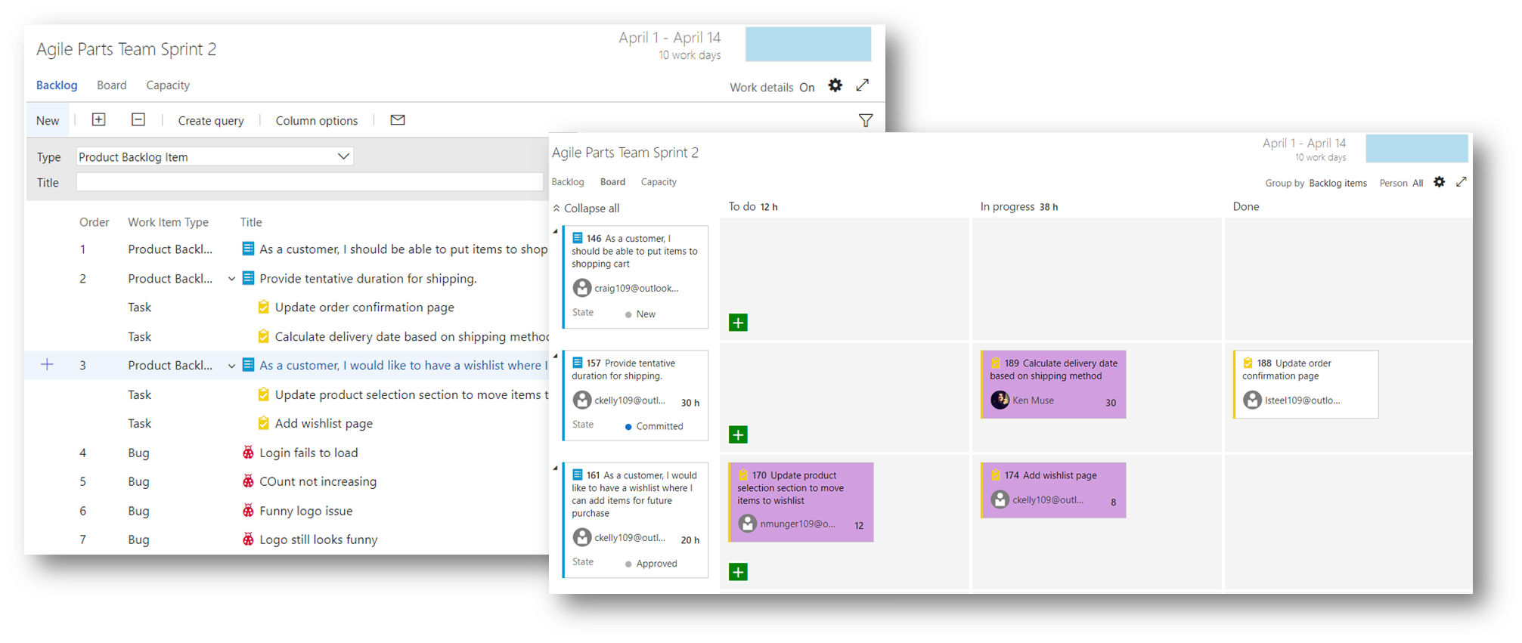
Plan & Track

Slide 20
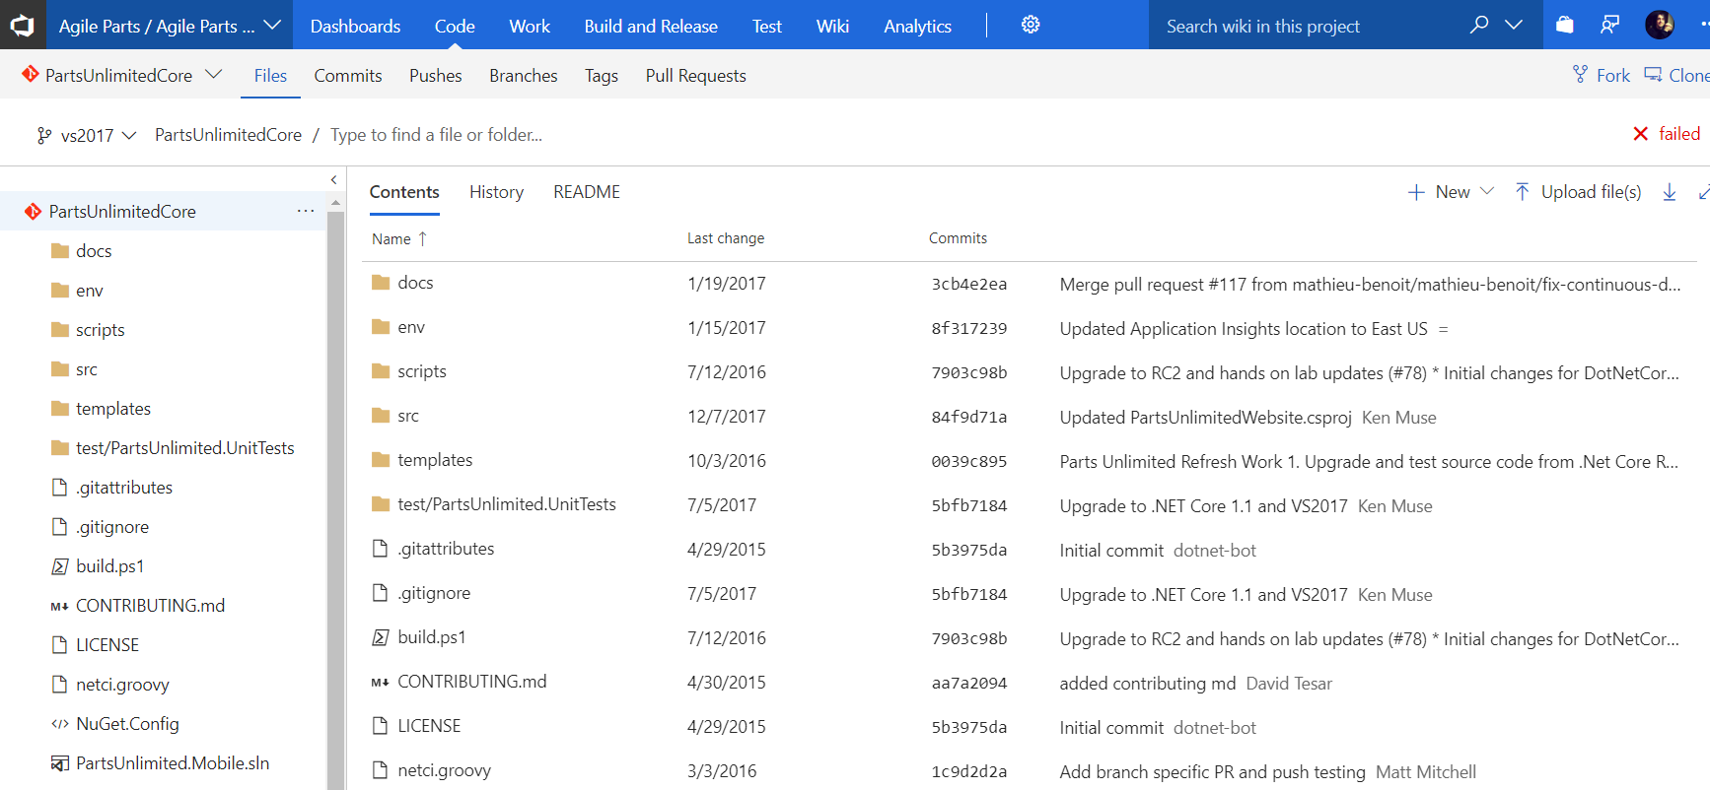
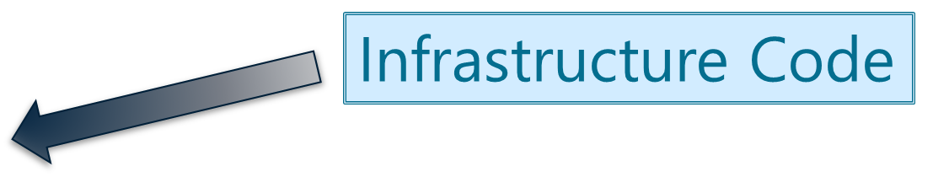
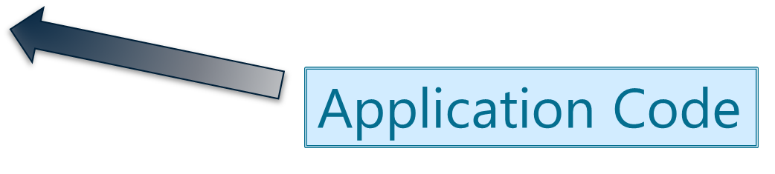
Develop & Test

Slide 21
Build & Release
A Build is responsible for compiling code, gathering resources, and organizing files into Artifacts that can be used in a release pipeline
A Release is responsible for deploying Artifacts into one or more environments and verifying the quality of the deployed release

Slide 22
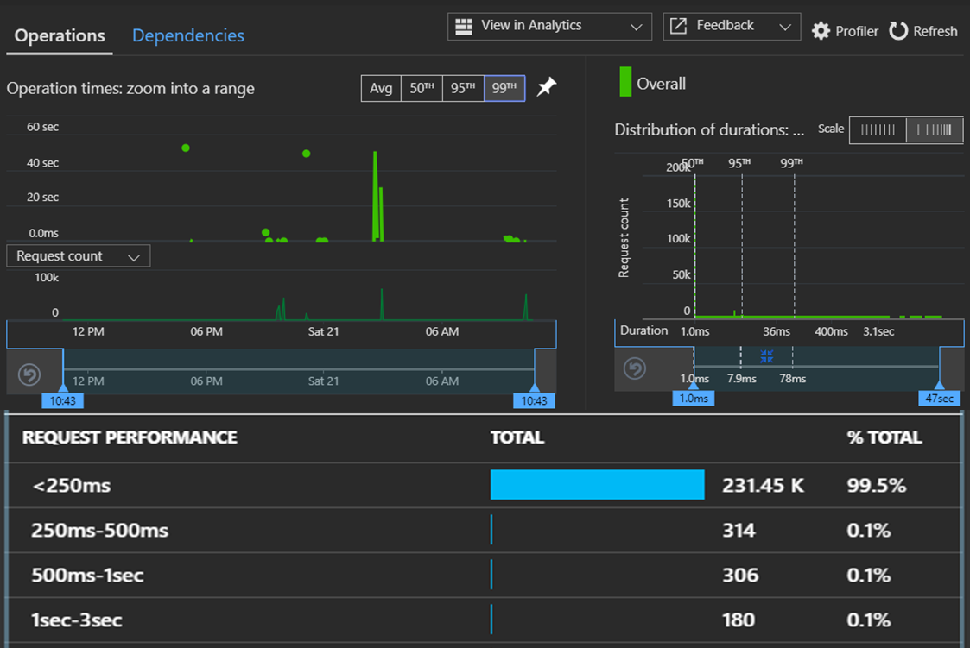
Monitor & Learn

Slide 23
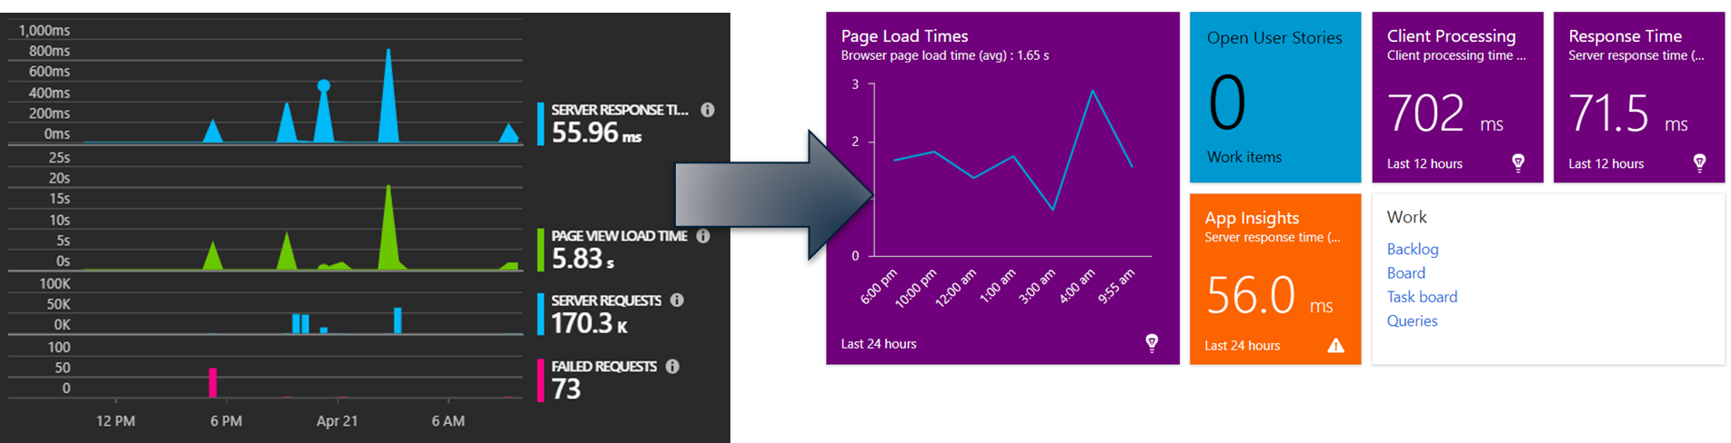
Monitor & Learn

Slide 24
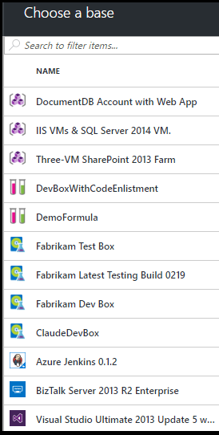
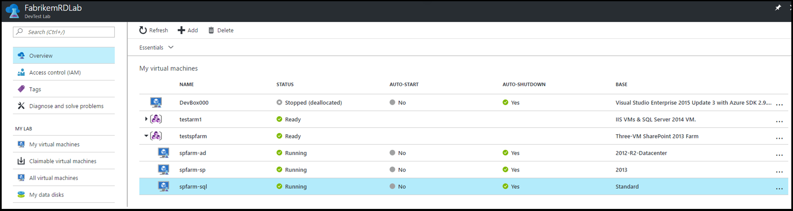
Self-Service Enablement: DevTest Labs

Slide 25

DevSecOps: Security embedded in DevOps
OSS Vulnerabilities
WhiteSource**
Container Security
Aqua**
Static Analysis Security Testing (SAST)
OWASP
SonarQube
AttackFlow
Brakeman
CPPCheck
LAPSE
.NET Security Guard
Coverity*
Parasoft**
VeraCode**
Fortify*
Checkmarx**
* - A commercial brand covering related security products
** - A company selling a security products
This Photo by Unknown Author is licensed under CC BY-SA

Slide 26
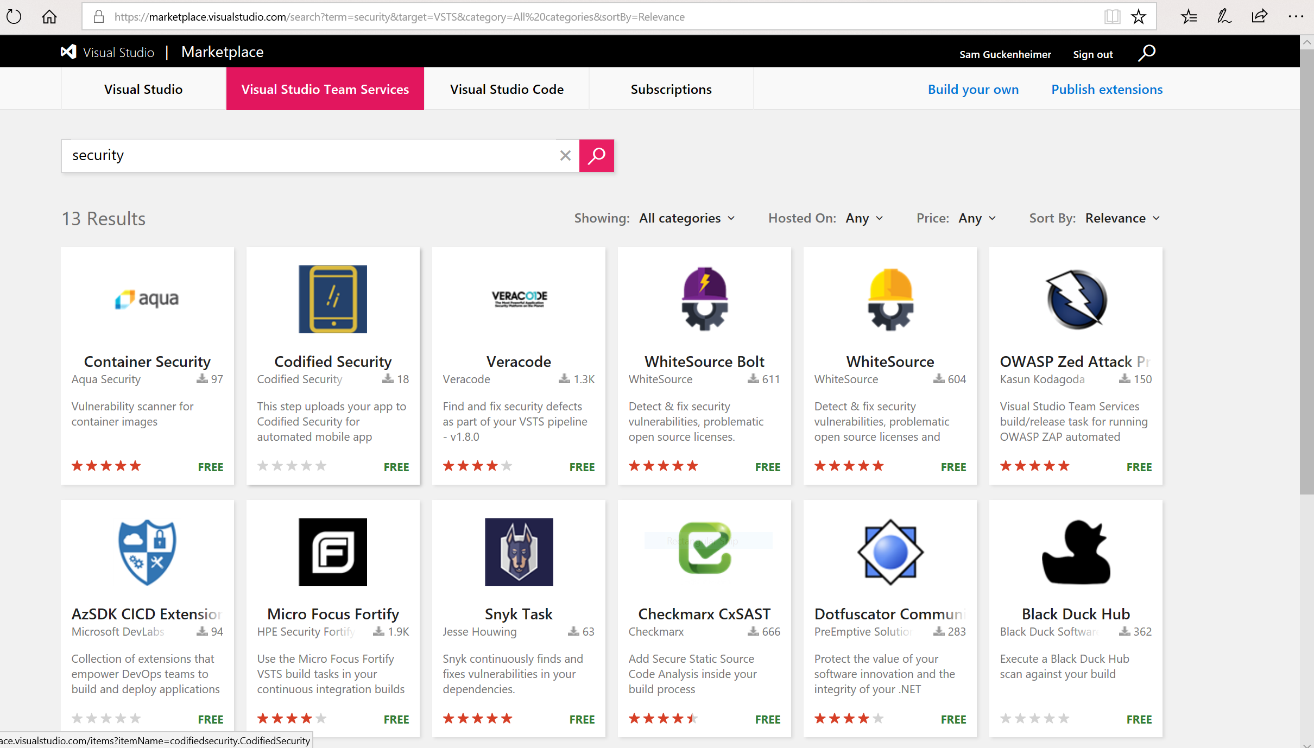

Slide 27
Roles and Responsibilities
Security - Incorporate security necessities into every aspect of the business; enable others to automate compliance
Development – Quickly build, deploy & update a product that our customers love; Enable other groups by building what they need to support you.
IS/IT – Build infrastructure as code; enable others by helping to eliminate waste throughout the technology landscape
Management – Enable the teams by giving them flexibility, guidance and support to do what is needed; remove obstacles
Senior Management – Embrace Cultural Change; Drive Transformation in the organization.
Everyone – Help build a product that will inspire our customers to become raving fans
Notes:
Security - Help find a way to incorporate security necessities into every aspect of the business; without getting in the way unnecessarily

Slide 28

Jumpstart Your Journey to the Azure Cloud
Special offer for attendees of this workshop!
FREE 3-5 day jumpstart for your company
Funded by Microsoft and Wintellect
Training and overviews for your team
Stand up a basic Azure subscription and workload
Deploy a basic Data, Analytics, or Cognitive Services POC
Get your DevOps going with a VSTS POC
For more details, contact us at info@wintellect.com

Slide 29


Use and orchestrate your favorite 3rd party tools. Your toolchain, seamlessly integrated with Azure.
“Azure support for Docker, Kubernetes, Puppet, Terraform, Cassandra, and other open source tools has become very important to us and has really accelerated our move into Azure.” – Robert Rudduck, Director of Architecture and DevOps Read the story
Notes:
Key quote:
The CI/CD process includes Infrastructure as Code, which allows security, networking, storage and compliance to be part of the development life cycle. When code is ready to deploy, it and the infrastructure on which it will run are deployed in tandem. Developers define the entire infrastructure using Azure platform services and open source tooling—Azure Resource Manager, Puppet, Terraform, and Microsoft Visual Studio Team Services.

Slide 30
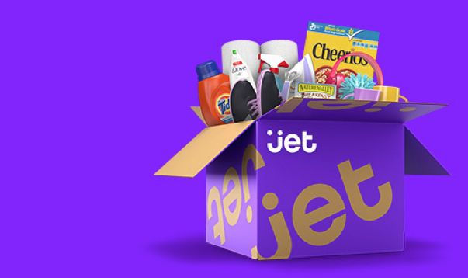
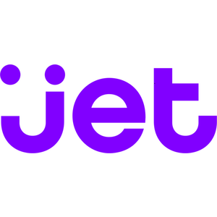
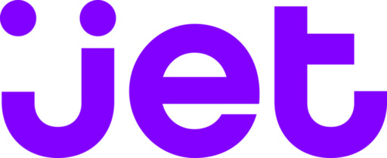
Spend less time building delivery pipelines and more time delivering software
E-commerce challenger eyes the top spot, simplifies development and delivery with DevOps on Azure “Being able to leverage so many off-the-shelf services and tools from Azure enabled us to go from zero to a full- fledged e-commerce marketplace in just about 12 months.” – Mike Hanrahan, CTO Read the story
Simple
“Being able to leverage so many off-the-shelf services and tools from Azure enabled us to go from zero to a full- fledged e-commerce marketplace in just about 12 months.” – Mike Hanrahan, CTO
Read the story
Notes:
Key quote:
The Microsoft Visual Studio development system is the primary IDE for back-end infrastructure, with Node being used on the front end. To get its code through development and into production as fast as possible, Jet uses a mix of Azure App Service, Azure Web Roles and custom servers, with deployment happening from Jenkins.

Slide 31


Deploy continuously and compliantly to enterprise-grade cloud services, with integrated security and monitoring.
“With DevOps and Azure, we’re able to reduce our new-feature release cycle down to one week, and we think we can even speed that up.” – Fikri Larguet, Director of Cloud Services
Read the story

Slide 32
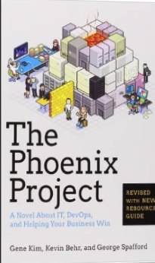
Tip: Must Read Book
Amazon…
The Phoenix Project: A Novel about IT, DevOps, and Helping Your Business Win Paperback
– October 16, 2014
The book is available on Audio Book; you can likely get it for free, if you do not already have an account. If you do not have an Audible Account, you get two free books when signing up for your free account.
Notes:
TAKE A PICTURE OF THIS SLIDE!
https://www.amazon.com/Phoenix-Project-DevOps-Helping-Business-ebook/dp/B00AZRBLHO

Slide 33
Resources

Slide 34
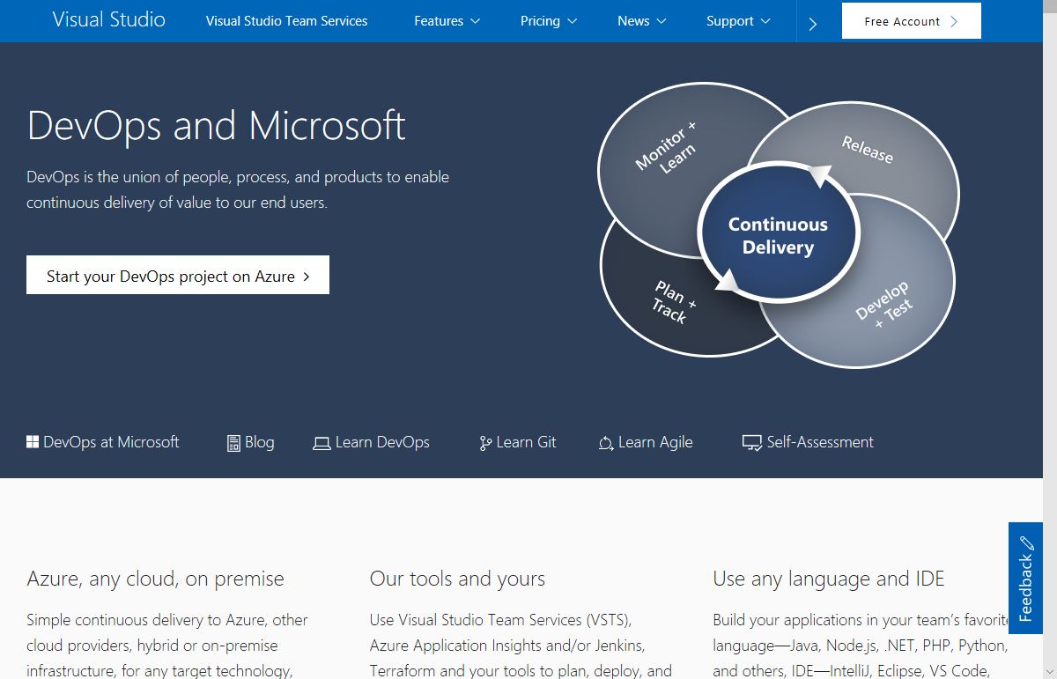

Slide 35
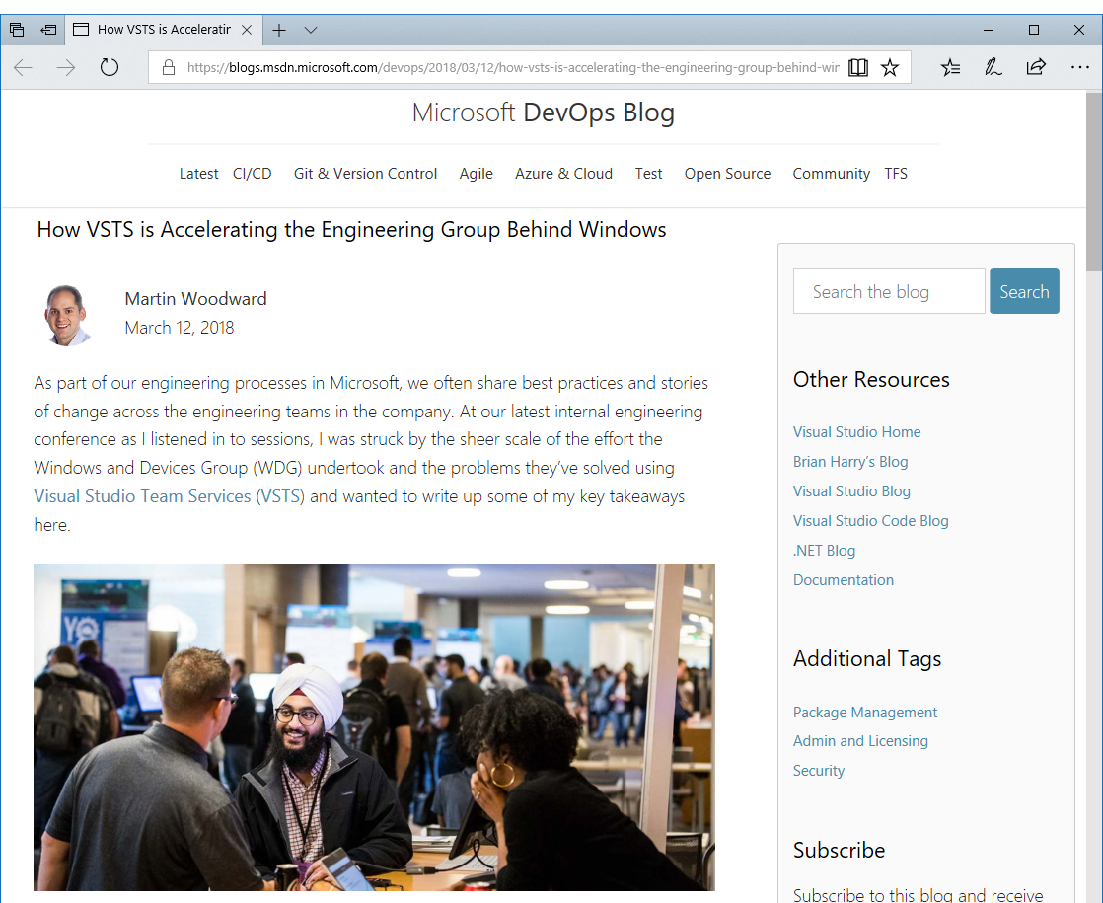
How VSTS is Accelerating the Engineering Group Behind Windows:
“With over 22,000 employees and 7,000 software developers in the group, it’s larger than many companies”
“The recent Fall Creators Update to Windows 10 consisted of around 4 million individual commits grouped into around 500,000 pull requests. All changes to the Windows code are reviewed via pull requests which has proven to be the best way to work in any Git team in Microsoft. It has taken significant engineering work to build a pull request system in VSTS that is able to handle pull requests at the scale of a group like WDG”
“WDG also puts a similar level of demand on the VSTS work tracking system. They currently have over 10 million work items tracking bugs, features and tasks etc”
“The WDG team has seen massive improvements in moving to VSTS, not just in pure throughput, but also in the satisfaction levels of engineers on the team. Engineer satisfaction is the one of the most important management metrics for WDG. This also reflects the change of culture not just in their group but also across Microsoft as a whole towards rewarding sharing and reuse”
“It’s been an incredible four years; we’ve come further than we could have imagined together through the power of DevOps and the benefits of encouraging a culture of sharing inside and outside the company.”

Slide 36
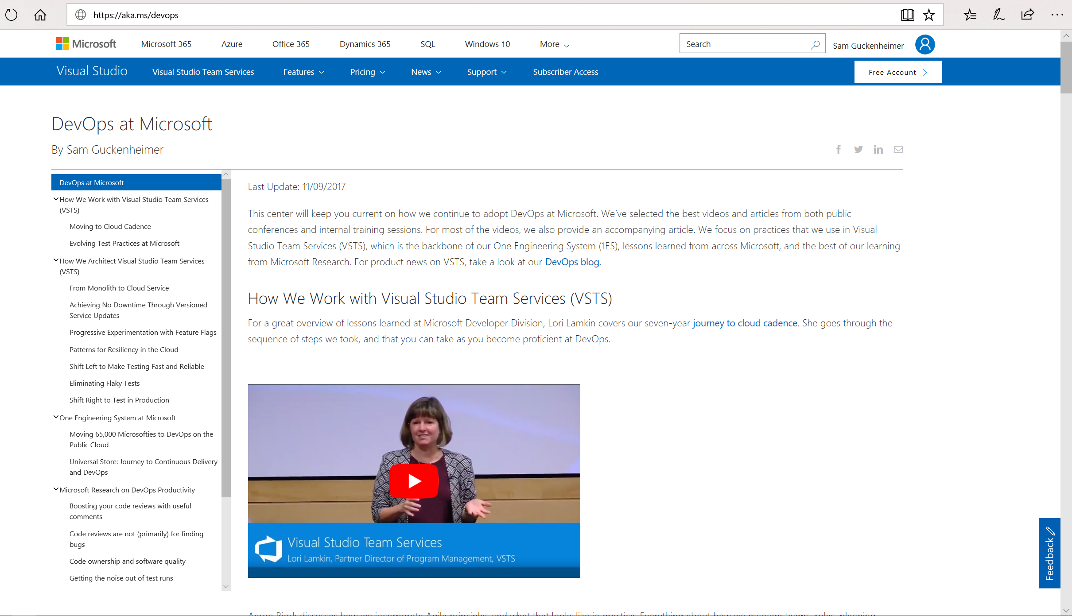
Share http://aka.ms/DevOps with your team:
Create a series of “Lunch & Learn” sessions based on our DevOps journey. At each session watch one video and have a follow up discussion with your team.
Or, treat it like a book club, i.e. have everyone watch a video and read the related narrative as an assignment, then have a discussion session over lunch.
Either way, discuss with your team what is/is not applicable to your company, (or, what should be applicable in the future).

Slide 37
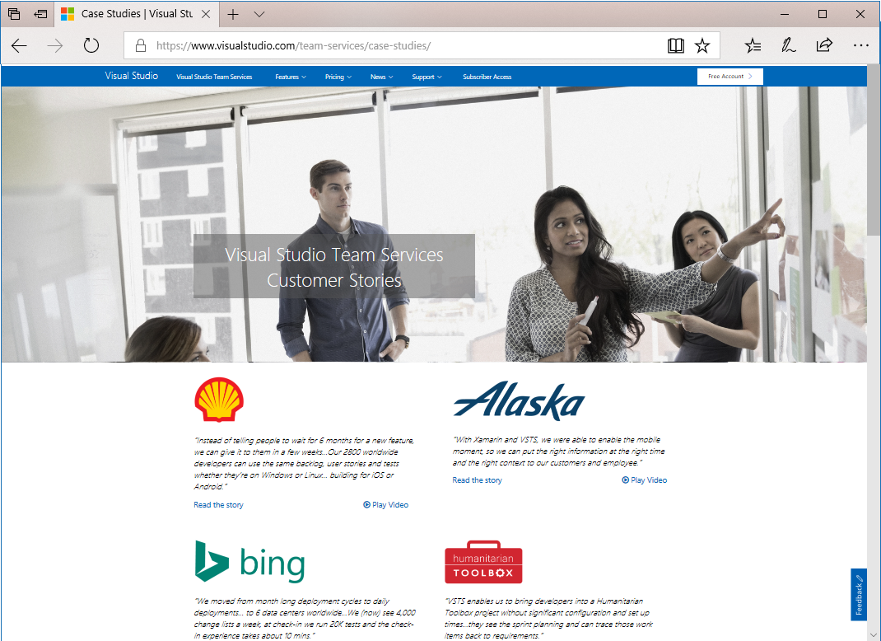
How are other customers continuously delivering value to their end users with DevOps? Check out our VSTS Customer Stories:
https://www.visualstudio.com/team-services/case-studies/

Slide 38
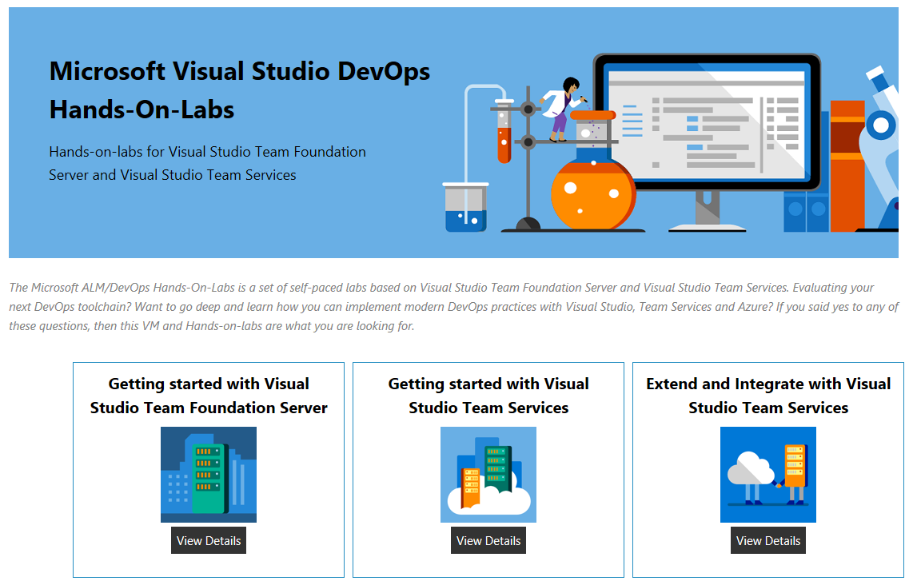

Slide 39
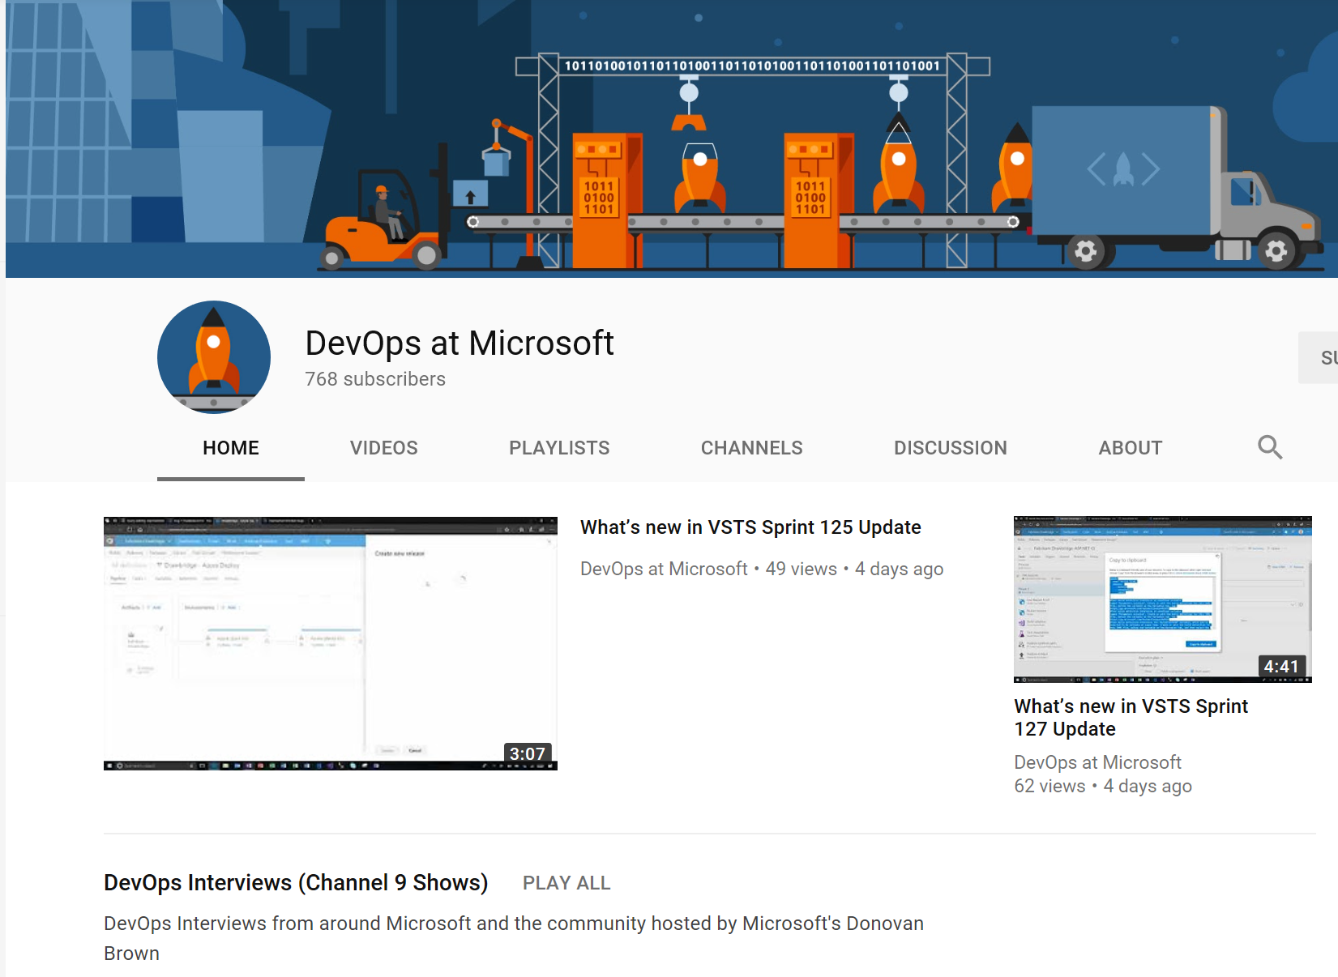
Subscribe to the ”DevOps at Microsoft” YouTube channel
Notes:
TAKE A PICTURE OF THIS SLIDE!

Slide 40
Resources What is DevOps? https://ptdrv.linkedin.com/2x6qwb3 Learn DevOps https://ptdrv.linkedin.com/5ljn2ey
Notes:
TAKE A PICTURE OF THIS SLIDE!

